Slide 1

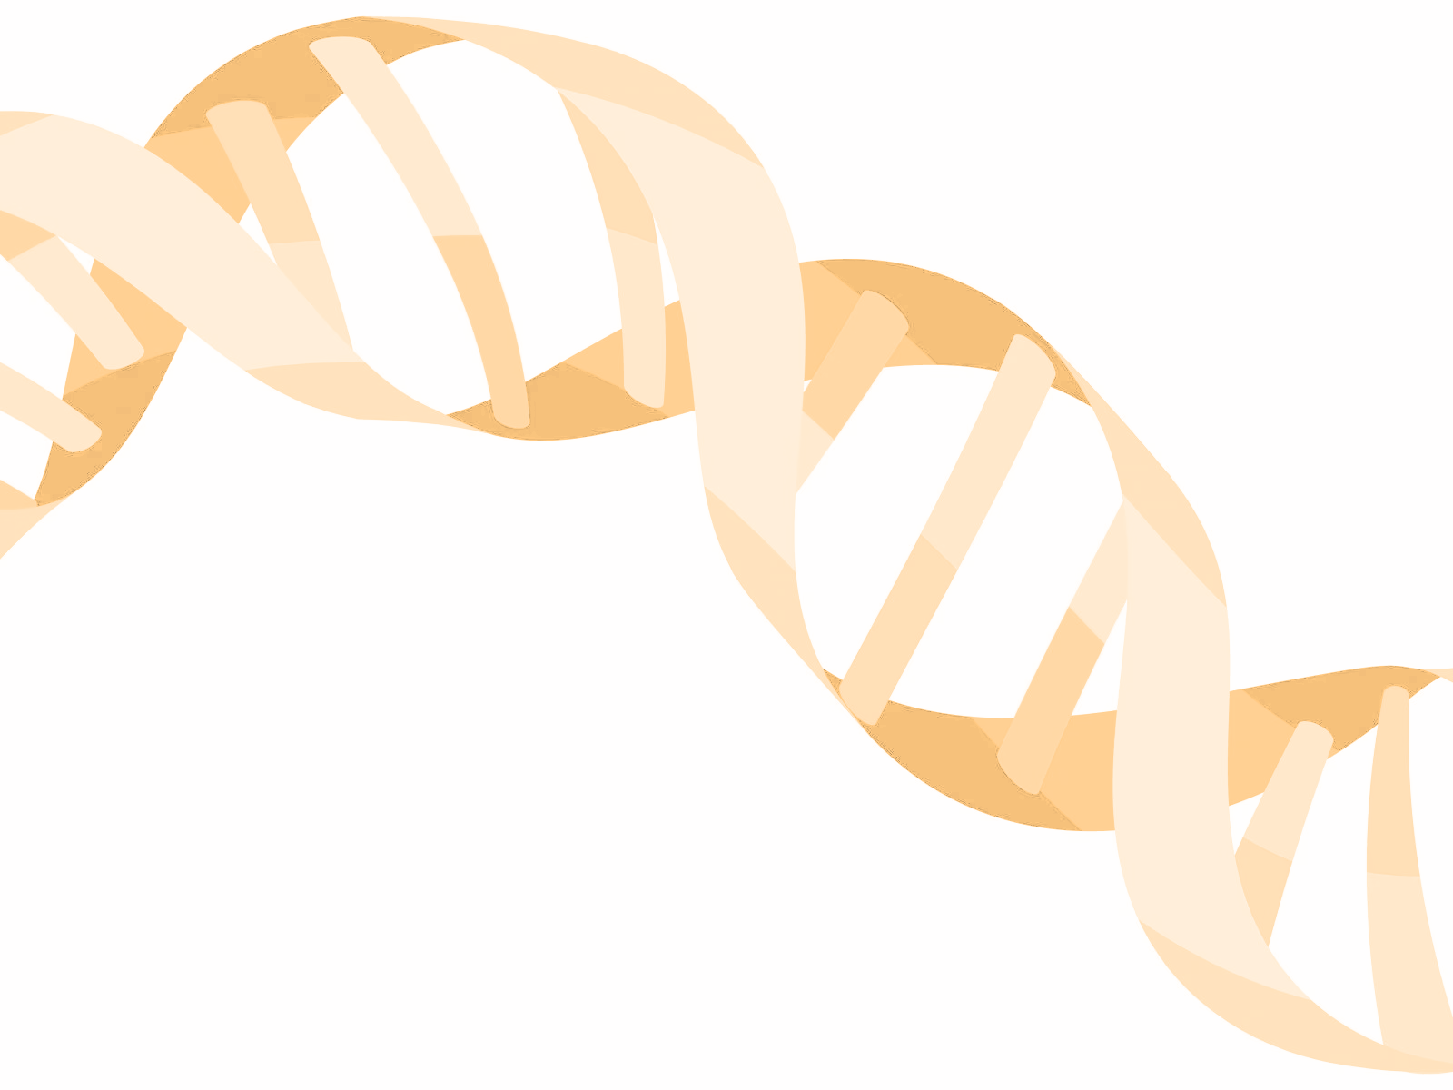
DNA-SEQ:
BRCA1/2 TARGET SEQUENCING - UPSTREAM ANALYSIS
Presenter: Duy Dao
-22/02/2025-

Slide 2

TABLE OF CONTENTS
DNA SEQ: UPSTREAM ANALYSIS
01
INTRODUCTION
02
RAW DATA PROCESSING
03
ALIGNMENT
04
MAPPED READS POST-PROCESSING
05
ALIGNMENT DATA: QUALITY CONTROL

Slide 3
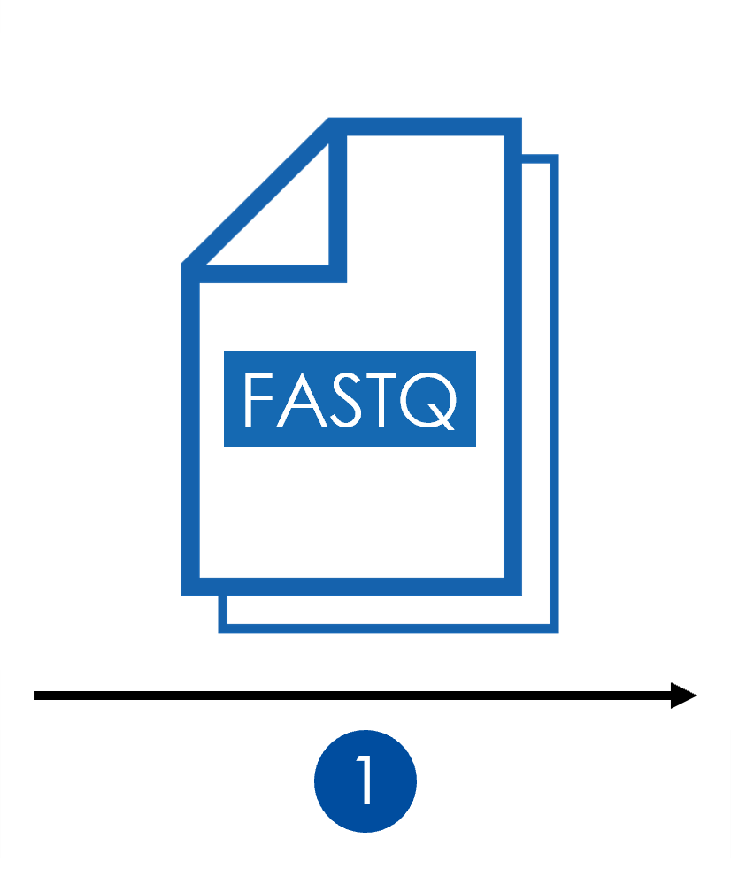



PREPARATION
Download Data: Raw fastq & Reference genome data
Install tools
Setup working directory

Slide 4
INTRODUCTION

Slide 5
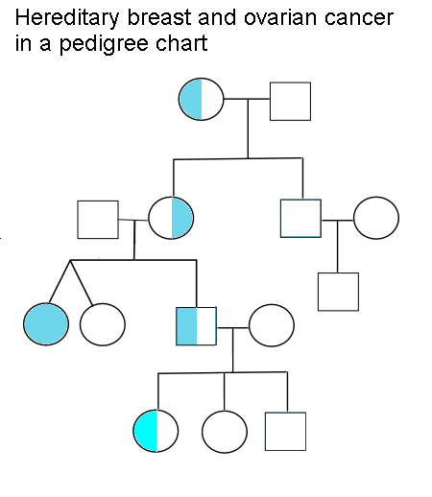

INTRODUCTION
Case: A patient suspected of having hereditary breast cancer was recommended to undergo BRCA1/2 testing.

Slide 6
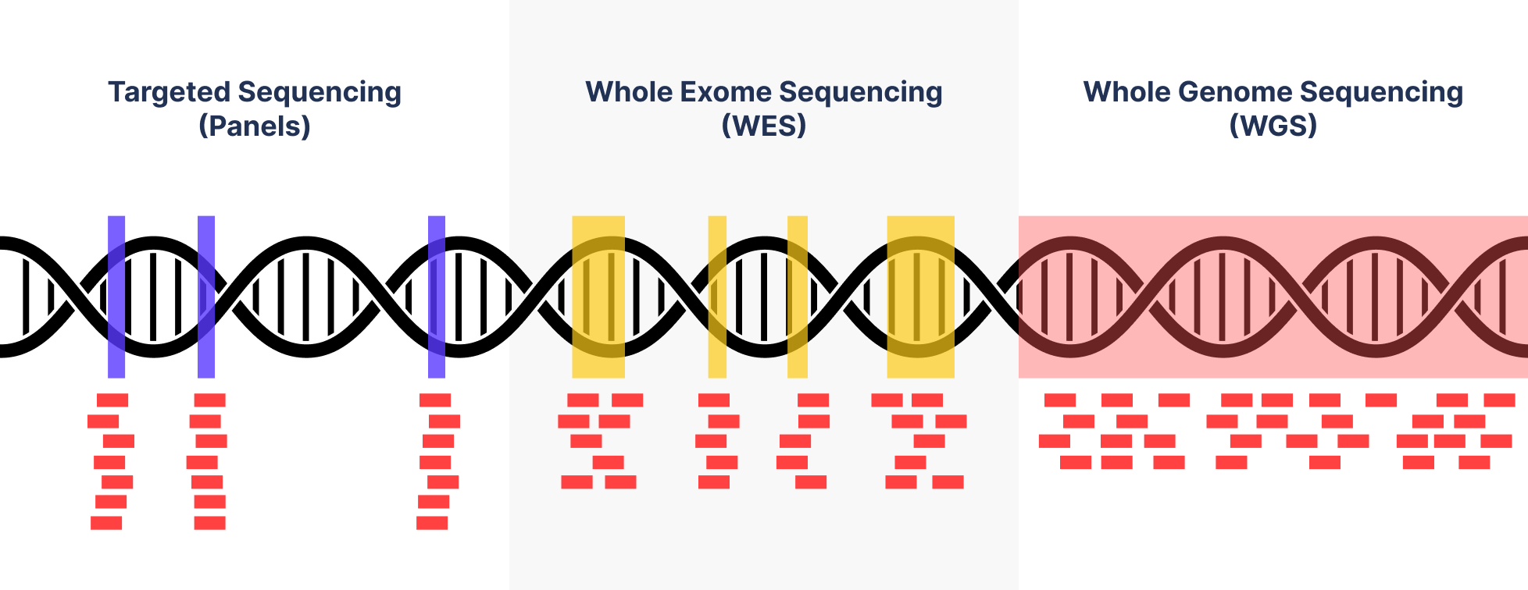
INTRODUCTION

Slide 7
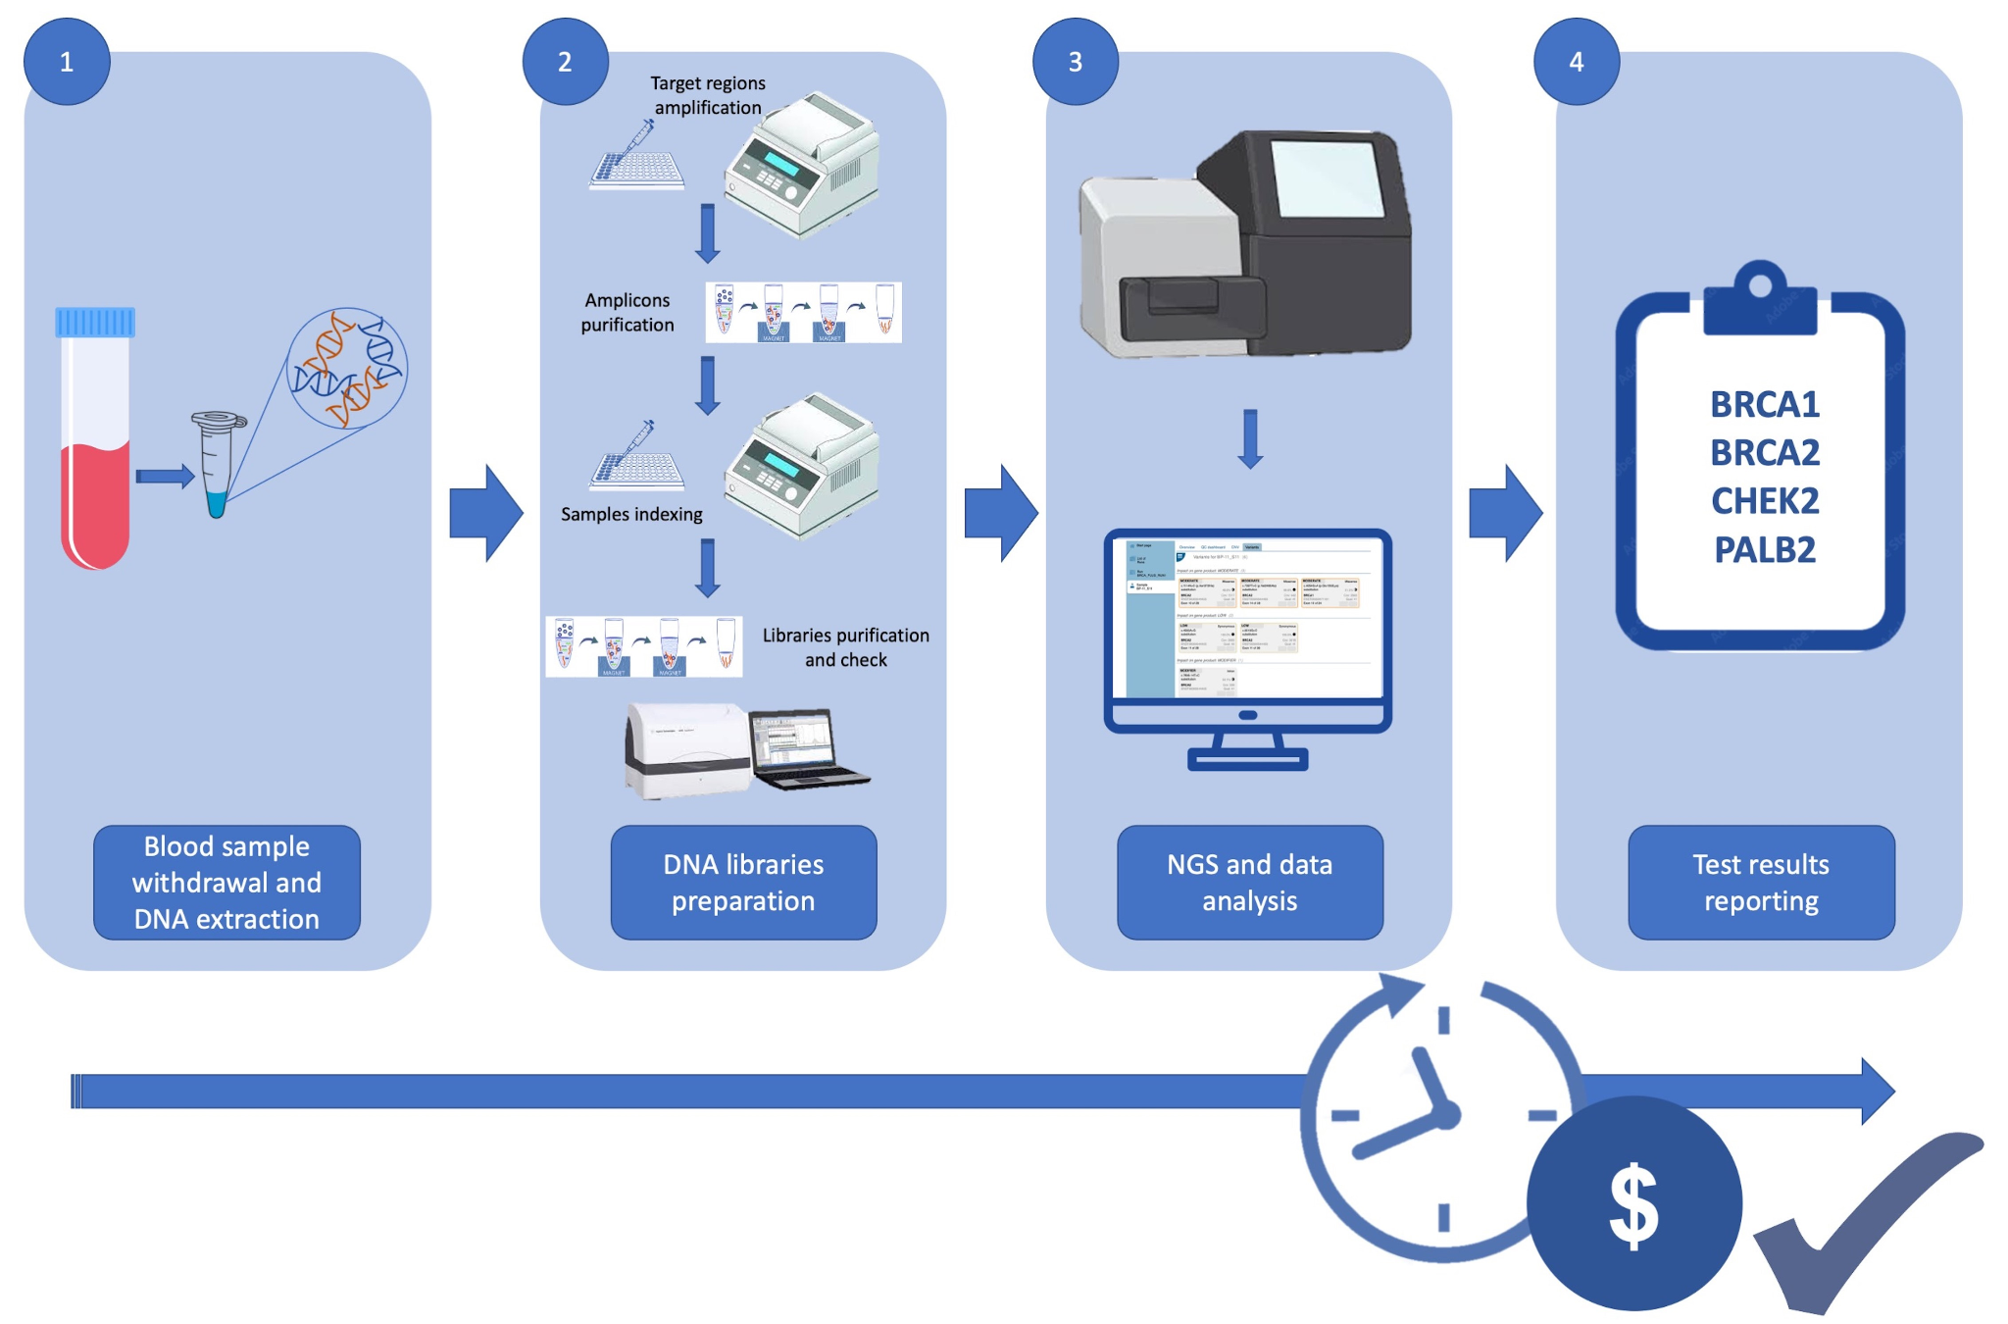
INTRODUCTION
Target sequencing workflow
https://www.mdpi.com/2073-4425/13/4/682?type=check_update&version=1

Slide 8
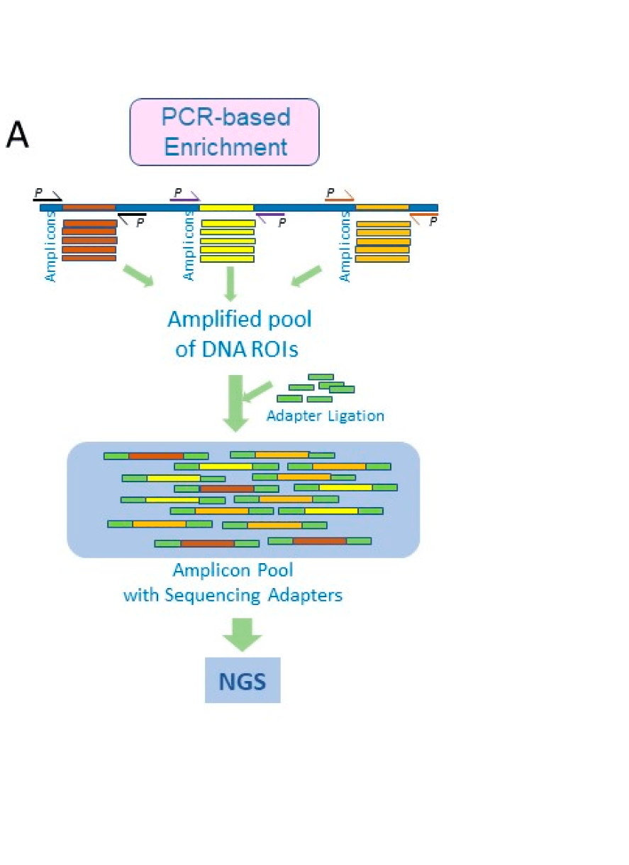
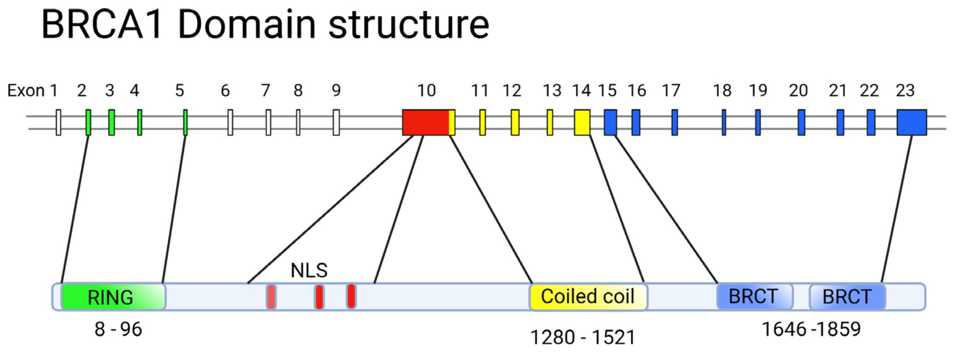
INTRODUCTION
https://www.mdpi.com/2075-4418/12/7/1539
https://www.mdpi.com/1422-0067/24/5/4982

Slide 9
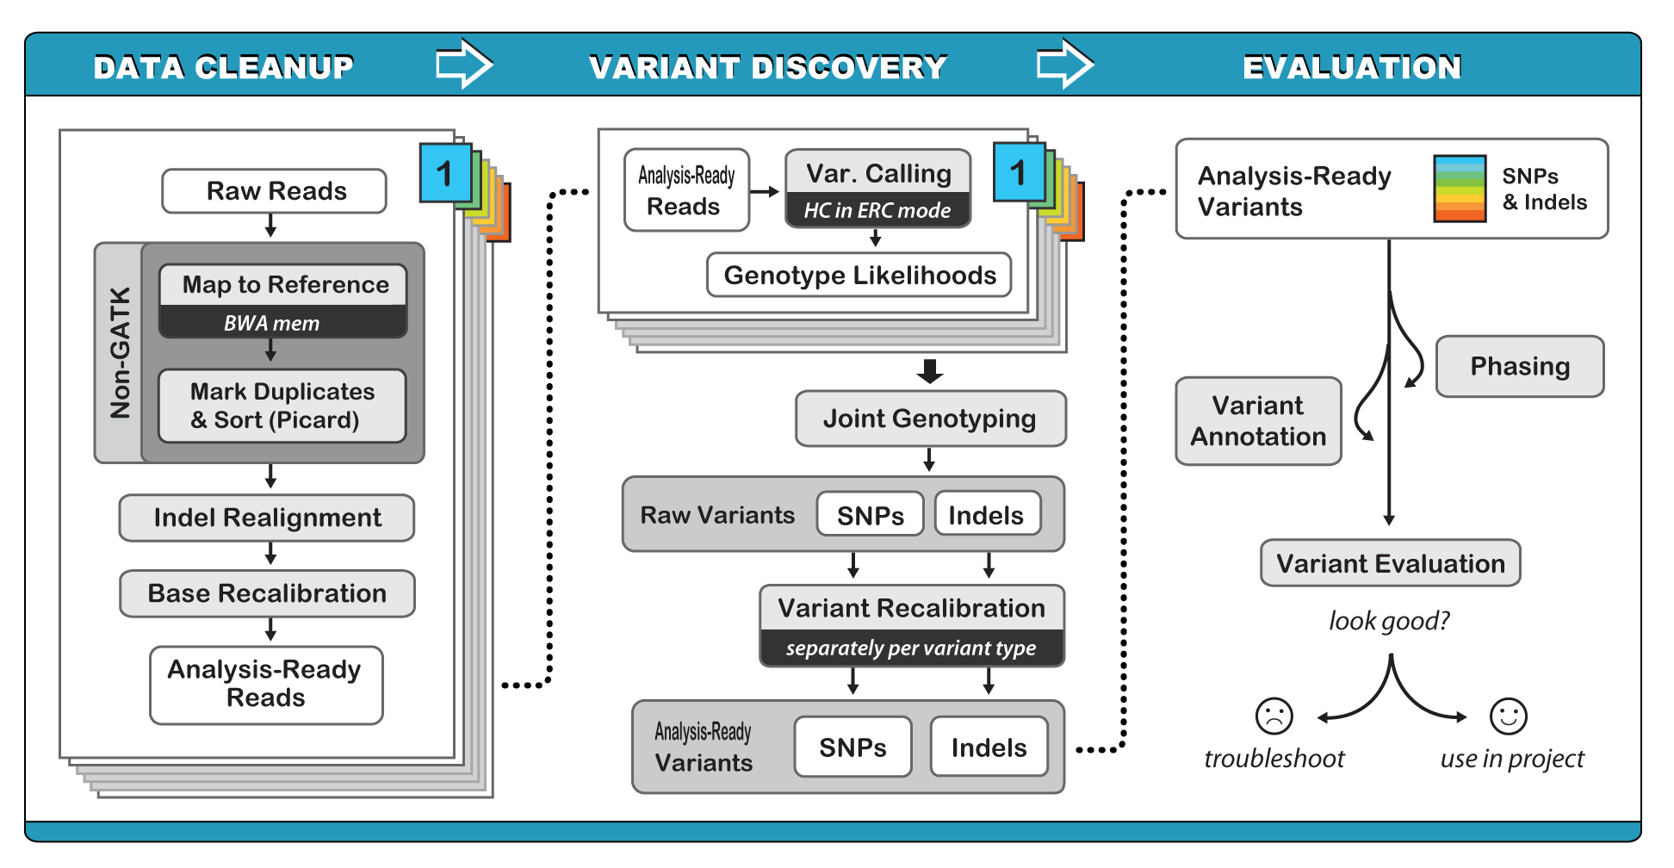
DNA sequencing Workflow
Upstream Analysis
Downstream Analysis

Slide 10


INTRODUCTION
CONCEPT
Why we need to pre-process the NGS data before further analysis?

Slide 11


INTRODUCTION
UPSTREAM ANALYSIS WORKFLOW
Yes
Mapped post-proccessing
Mapping
bwa
GATK
Quality looks good?
raw data
QC
Aligment QC
FastQC
No
Trimming
GATK
Trimmomatic
FastQC
Downstream Analysis

Slide 12
RAW DATA PRE-PROCESSING

Slide 13

RAW DATA PROCESSING
What is raw data?
What is a fastq file (Illumina)?
Does your data look good? How to check it?
How to keep the good and eliminate the bad quality?

Slide 14
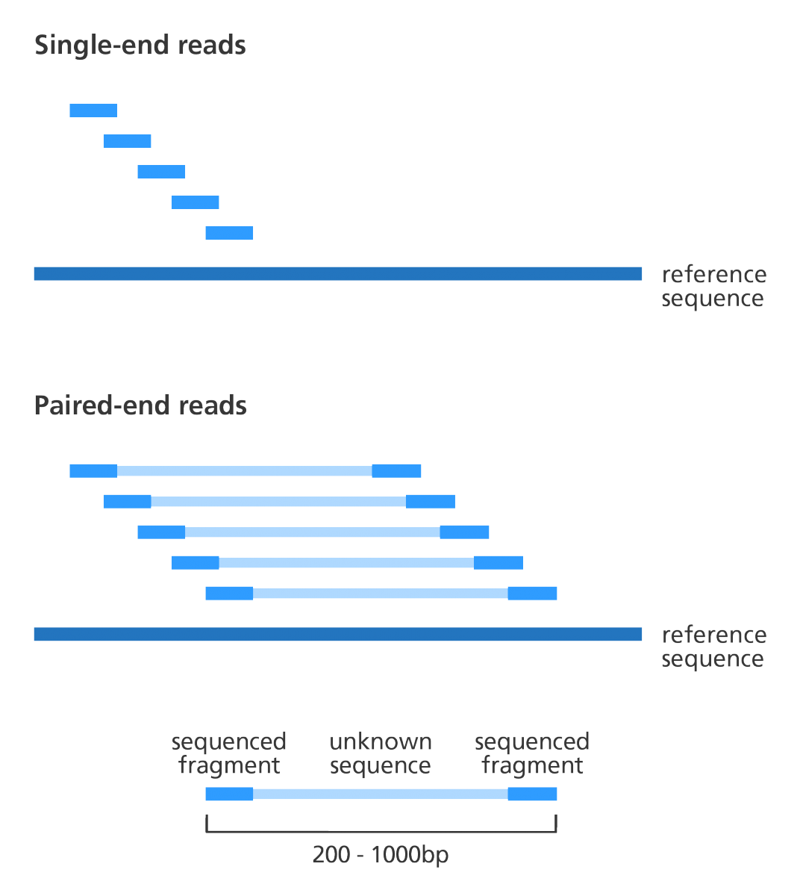
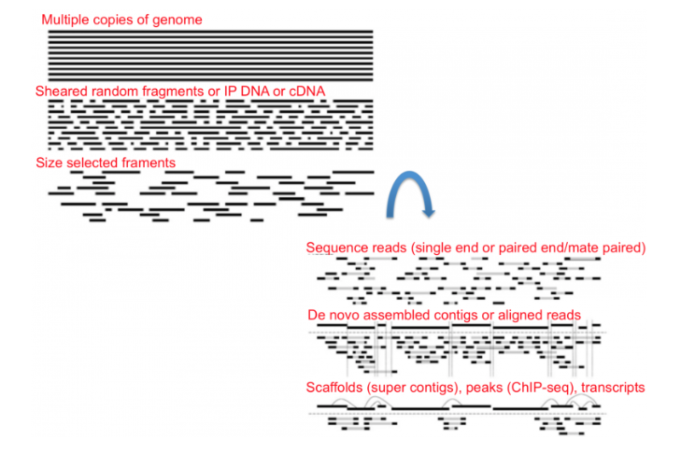

RAW DATA PROCESSING
What is raw data?
Short reads
The reads (sequences)
https://learn.gencore.bio.nyu.edu/ngs-file-formats/how-sequencing-works/

Slide 15
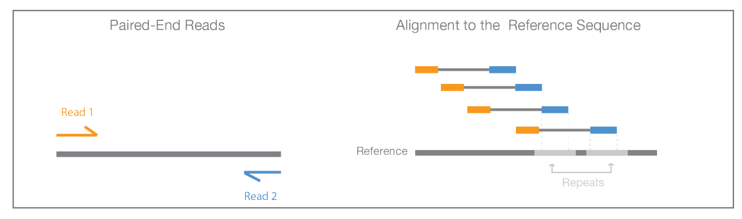
RAW DATA PROCESSING
What is raw data?
R1.fastq (forward read)
Paired-End reads
R2.fastq (reverse read)
https://www.illumina.com/content/dam/illumina-marketing/documents/products/illumina_sequencing_introduction.pdf

Slide 16
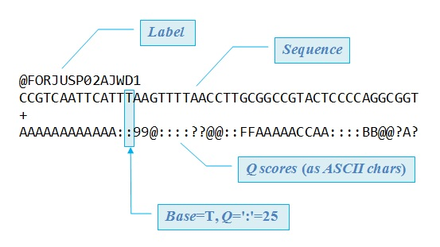
RAW DATA PROCESSING
INTRODUCE TO FASTQ FILE
What is a fastq file (Illumina)?
@<title and optional description>
<sequence line>
+<optional repeat of title line>
<quality line>
File Format

Slide 17
RAW DATA PROCESSING
INTRODUCE TO FASTQ FILE
Illumina FASTQ file naming scheme
NIST7035_TAAGGCGA_L001_R1_001.fastq.gz
sample_name: NIST7035
barcode_sequence: TAAGGCGA
lane: L001
read_number: R1
set_number: 001
> What is the meaning of fastq file’s name?

Slide 18
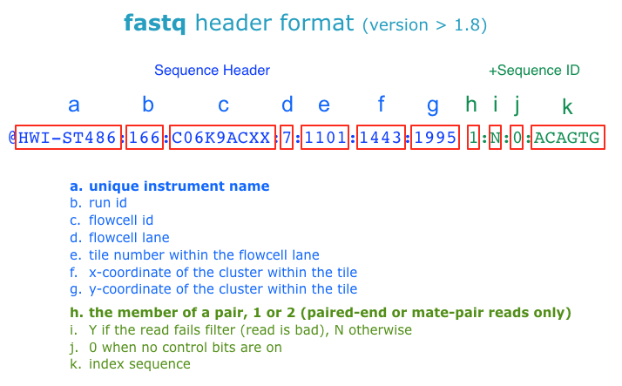
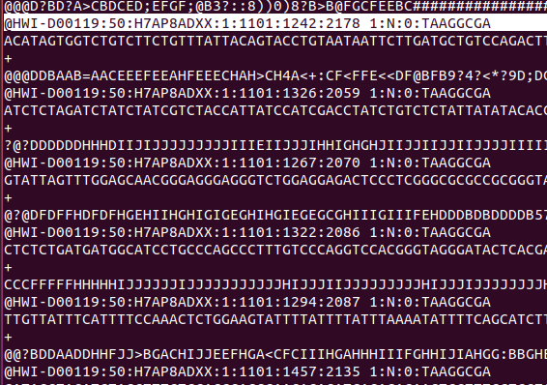
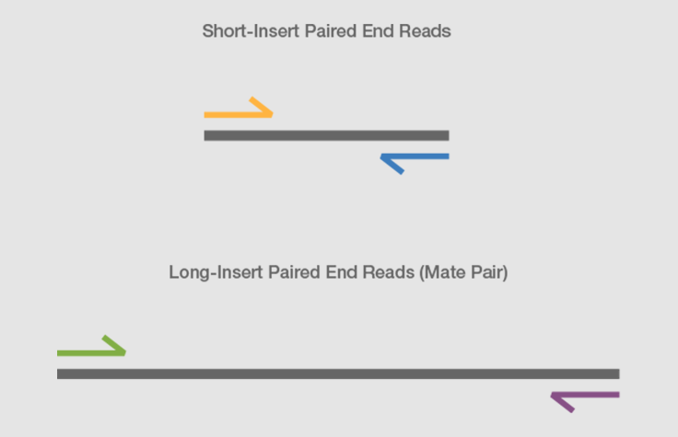
RAW DATA PROCESSING
INTRODUCE TO FASTQ FILE
Illumina FASTQ read naming scheme (header of each read)
The header Begin witn an ‘@’
> What is the meaning of the reads' name?

Slide 19
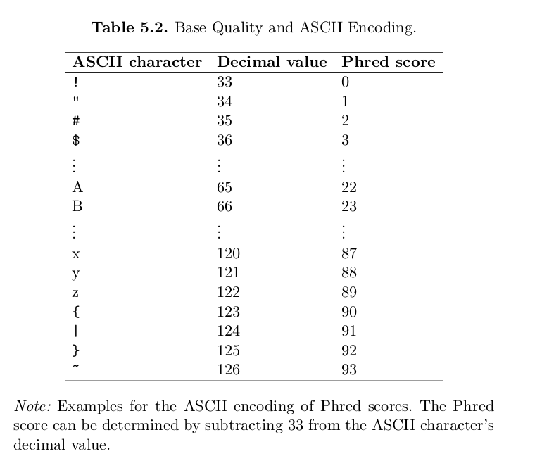
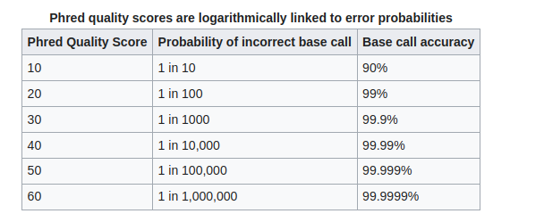

RAW DATA PROCESSING
INTRODUCE TO FASTQ FILE
Base Quality Score (Q-score)
“Measure of the confidence level in the accuracy of each nucleotide base call.”
Phred 33
Q30 is considered a benchmark for quality in next-generation sequencing.

Slide 20
RAW DATA PROCESSING
Classwork 1
Interpret these headers
1
2
What is the ID of the instrument?
What is the ID of the flowcell?
Which lane is this read in?
What tile is this read in?
Forward or Reverse read?

Slide 21
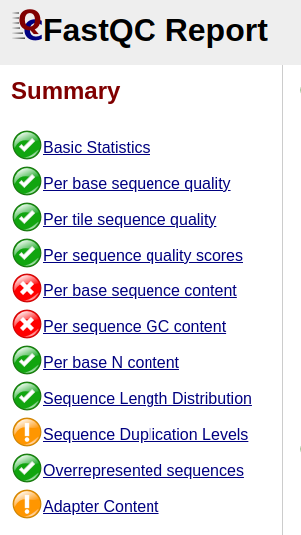
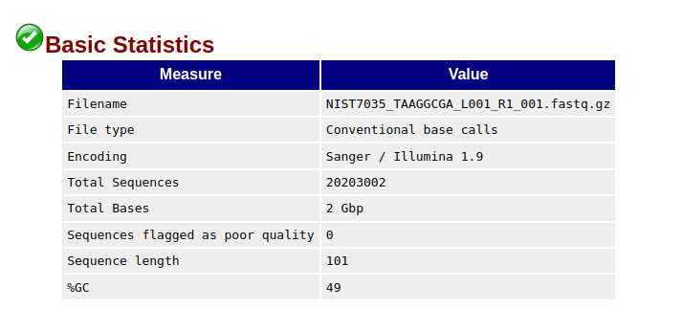
RAW DATA PROCESSING
SEQUENCE QUALITY CONTROL (FASTQC)
> FASTQC Summary
“FASTQC is a useful tool to check sequences quality.”

Slide 22
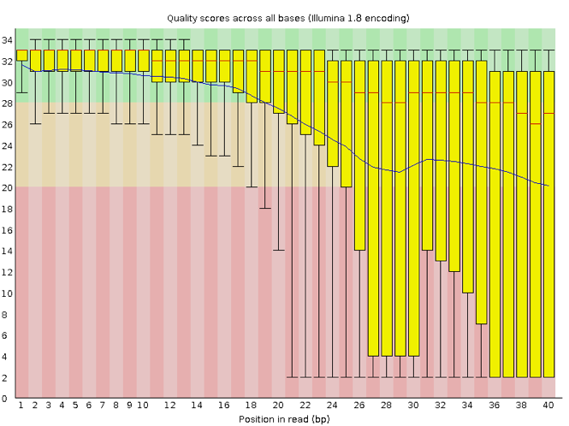
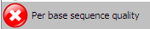
RAW DATA PROCESSING
SEQUENCE QUALITY CONTROL (FASTQC)
> Per base sequence quality
This module evaluates the quality at each base for all reads.
Box-plot: Yellow
Median: Red line
Mean: Blue line
< Example of a bad quality score reads (40 bp)

Slide 23
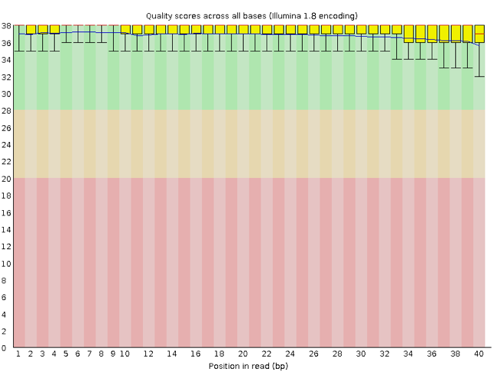

RAW DATA PROCESSING
SEQUENCE QUALITY CONTROL (FASTQC)
> Per base sequence quality
Good quality score (Q30)

Slide 24
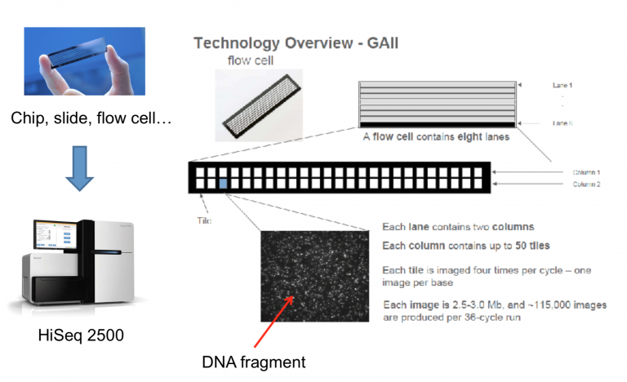
RAW DATA PROCESSING
SEQUENCE QUALITY CONTROL (FASTQC)
> Per tile sequence quality
What is a tile?
Information about tile stored in header of fastq

Slide 25
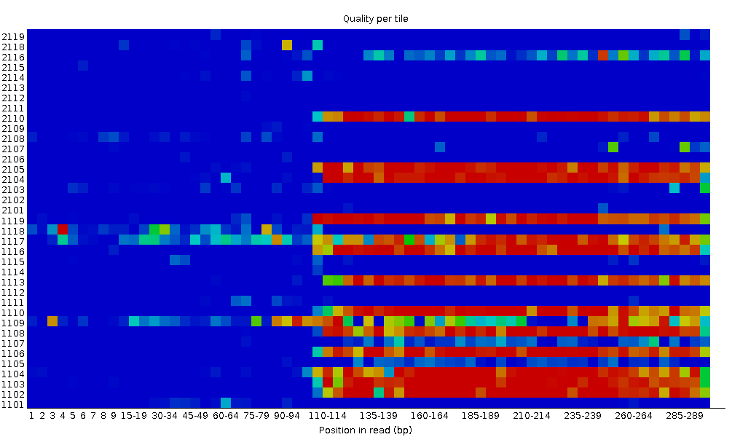
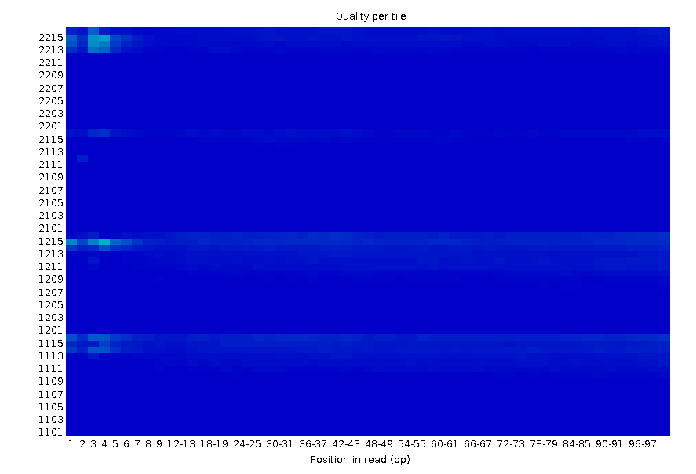


RAW DATA PROCESSING
SEQUENCE QUALITY CONTROL (FASTQC)
> Per tile sequence quality
Sequencing errors: bubbles, smudges, or dirt.
→ Cannot be fixed with bioinformatics

Slide 26
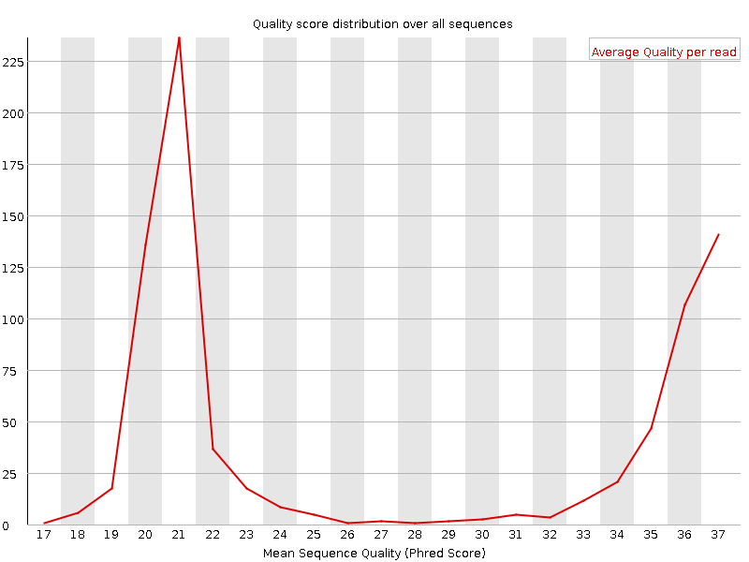
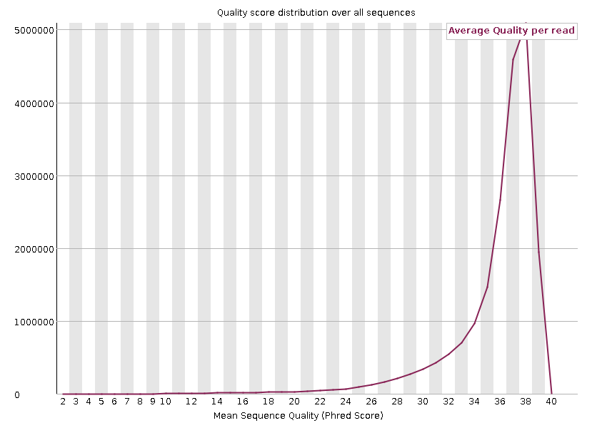
RAW DATA PROCESSING
SEQUENCE QUALITY CONTROL (FASTQC)
> Per sequence quality scores
“The average quality score over the full length of all reads.”

Slide 27
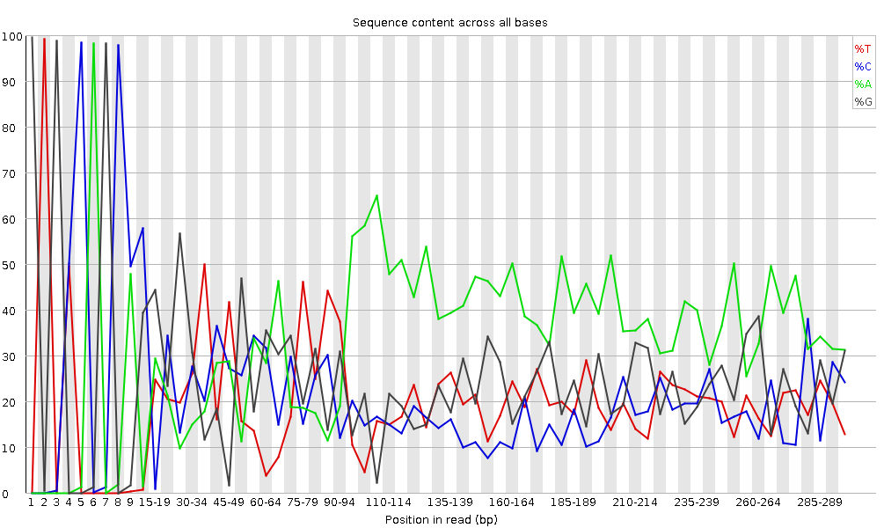
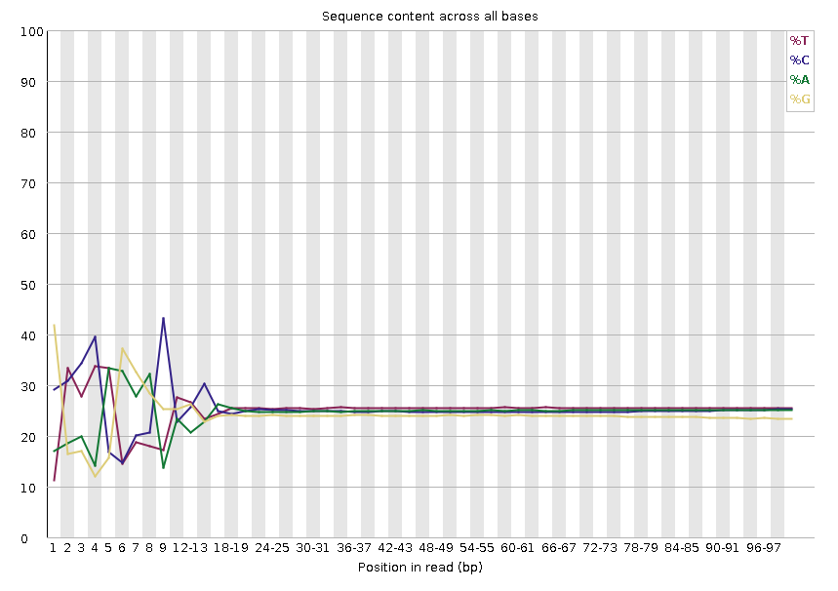
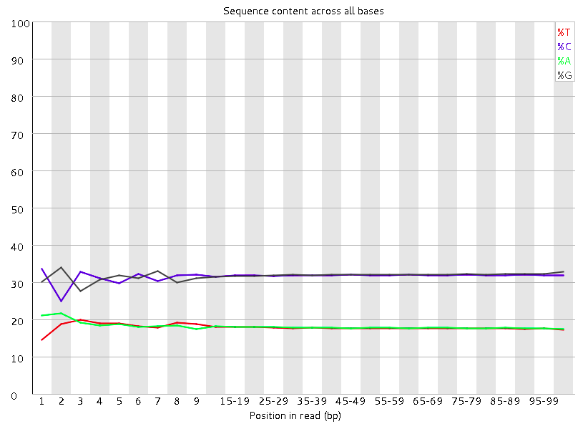
RAW DATA PROCESSING
SEQUENCE QUALITY CONTROL (FASTQC)
> Per Base Sequence Content
“Per Base Sequence Content” plots the percentage of each of the four nucleotides (T, C, A, G) at each position across all reads in the input sequence file.
- Parallel
- %A=%T
- %G=%C
Biased fragmentation (first 12 bp)
https://www.bioinformatics.babraham.ac.uk/projects/fastqc/
Notes:
It's worth noting that some types of library will always produce biased sequence composition, normally at the start of the read
Libraries produced by priming using random hexamers (including nearly all RNA-Seq libraries), and those which were fragmented using transposases, will contain an intrinsic bias in the positions at which reads start (the first 10-12 bases). This bias does not involve a specific sequence, but instead provides enrichment of a number of different K-mers at the 5’ end of the reads.
Whilst this is a true technical bias, it isn’t something which can be corrected by trimming and in most cases doesn’t seem to adversely affect the downstream analysis. It will, however, produce a warning or error in this module.
Warning
This module issues a warning if the difference between A and T, or G and C is greater than 10% in any position.
Failure
This module will fail if the difference between A and T, or G and C is greater than 20% in any position.

Slide 28
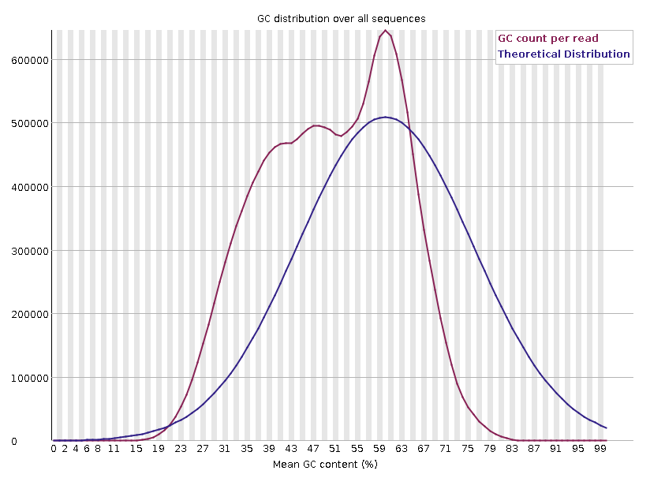
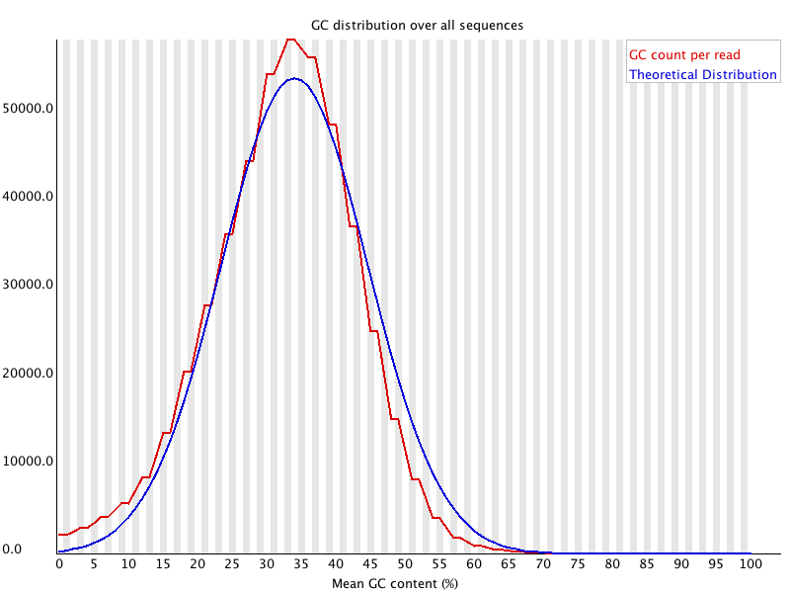
RAW DATA PROCESSING
SEQUENCE QUALITY CONTROL (FASTQC)
> Per sequence GC content
Deviations from this theoretical distribution often implies contamination of some kind (adapter/primer dimers, multiple species in the run)
Notes:
show the proportion of GC content in the reads
the modal GC content is calculated from the observed data and used to build a reference distribution.
An unusually-shaped distribution could indicate a contaminated library or some other kind of biased subset.

Slide 29
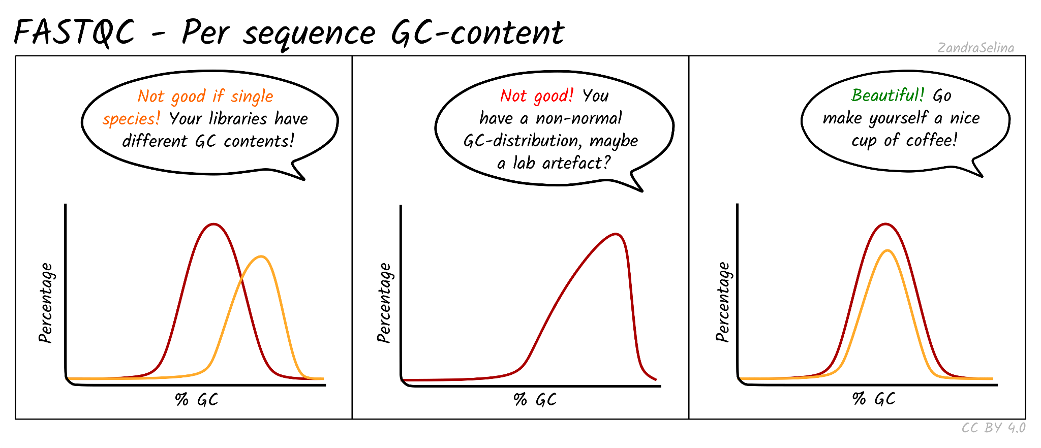
RAW DATA PROCESSING
SEQUENCE QUALITY CONTROL (FASTQC)
> Per sequence GC content
https://nf-co.re/eager/2.2.0/docs/output

Slide 30
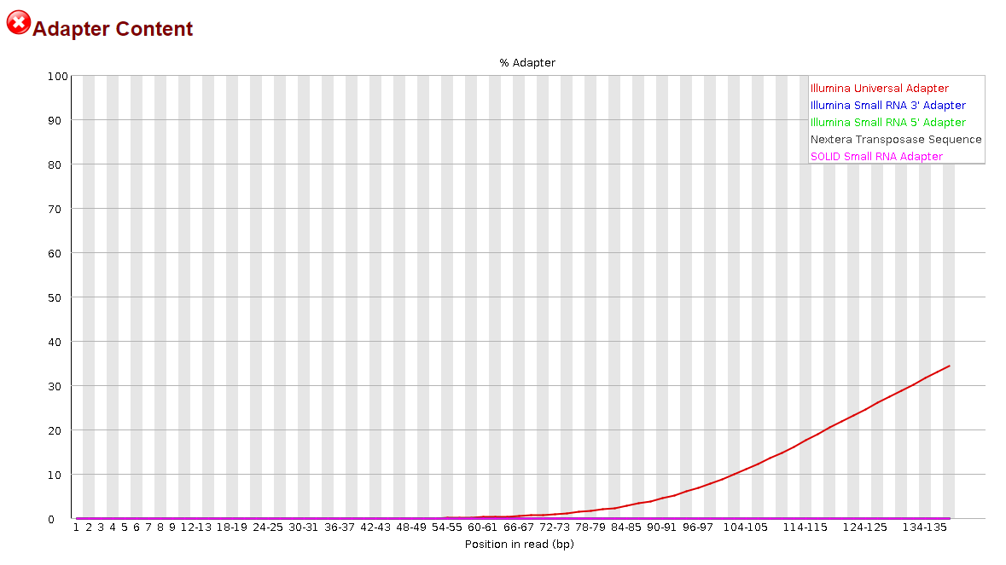
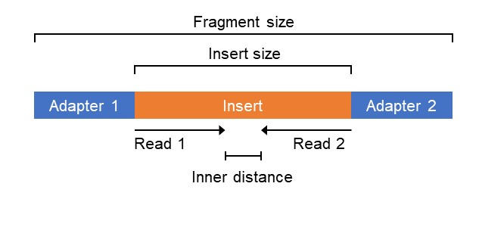
RAW DATA PROCESSING
SEQUENCE QUALITY CONTROL (FASTQC)
> Adapter Content
The Adapters need to be removed

Slide 31
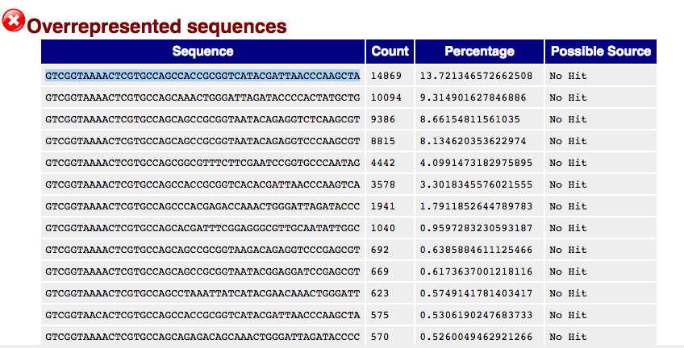
RAW DATA PROCESSING
SEQUENCE QUALITY CONTROL (FASTQC)
> Overrepresented sequences
Contaminated?
Adapter?
RNA transcripts?
FastQC lists all of the sequence which make up more than 0.1% of the total.
Notes:
Finding that a single sequence is very over-represented in the set either means that it is highly biologically significant, or indicates that the library is contaminated, or not as diverse as expected.
FastQC lists all of the sequence which make up more than 0.1% of the total.

Slide 32
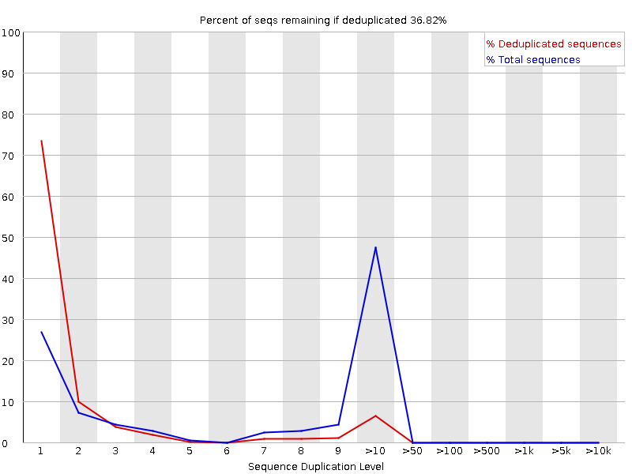
RAW DATA PROCESSING
SEQUENCE QUALITY CONTROL (FASTQC)
> Sequence duplication levels
2 types of Duplication Error:
PCR duplication
Optical duplication
→ Map and dectect which type.

Slide 33

RAW DATA PROCESSING
How to deal with these problems?
Things that we (bioinformaticians) can do:
Filter and remove bad sequences
Remove duplicated sequences
Remove adapter
Crop bad quality bases at the head/tail of sequences.
Things we can't:
Completely remove contaminants
Control GC contents.
(Control previous steps: library prep, sequencing)

Slide 34


RAW DATA PROCESSING
READ TRIMMING & FILTERING
This program does adaptive quality trimming, head and tail crop, and adaptor removal.
Trimming:
Quality trimming
Adapter trimming.
Check QC → Trim → Check QC again.
https://home.cc.umanitoba.ca/~psgendb/doc/TrimmomaticManual.pdf

Slide 35
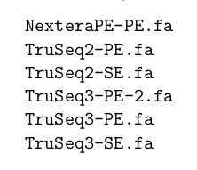
RAW DATA PROCESSING
Quality Trimming & Adapter removal
Syntax:
# trim S11 exec
trimmomatic PE \
-phred33 \
-threads 56 \
-trimlog $p_trim/S11.log \
-summary $p_trim/S11_sum.log \
$p_raw/S11_L001_R1_001.fastq.gz \
$p_raw/S11_L001_R2_001.fastq.gz \
$p_trim/S11_L001_R1_trimmed_paired.fastq.gz \
$p_trim/S11_L001_R1_trimmed_unpaired.fastq.gz \
$p_trim/S11_L001_R2_trimmed_paired.fastq.gz \
$p_trim/S11_L001_R2_trimmed_unpaired.fastq.gz \
ILLUMINACLIP:/mnt/rdisk/duydao/PROJECT/DNASEQ_BRCA12/ref/adapters/TruSeq3-PE-2.fa:2:30:10:8:3:true \
HEADCROP:5 \
CROP:140 \
LEADING:3 \
TRAILING:10 \
SLIDINGWINDOW:4:28 \
MINLEN:36

Slide 36
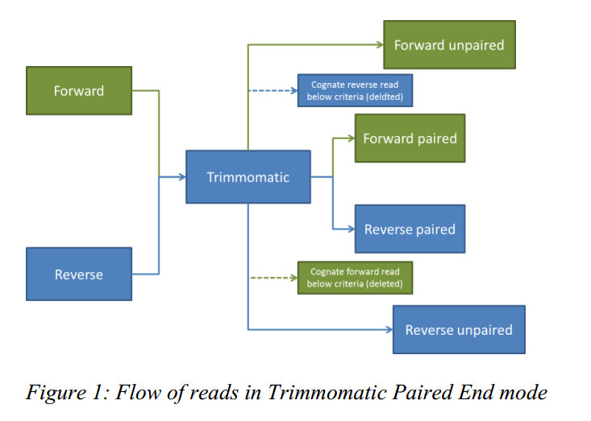
RAW DATA PROCESSING
TRIMMOMATIC WORKFLOW
Output
Input
Result:
trimmed fastq
Ready to do Mapping

Slide 37
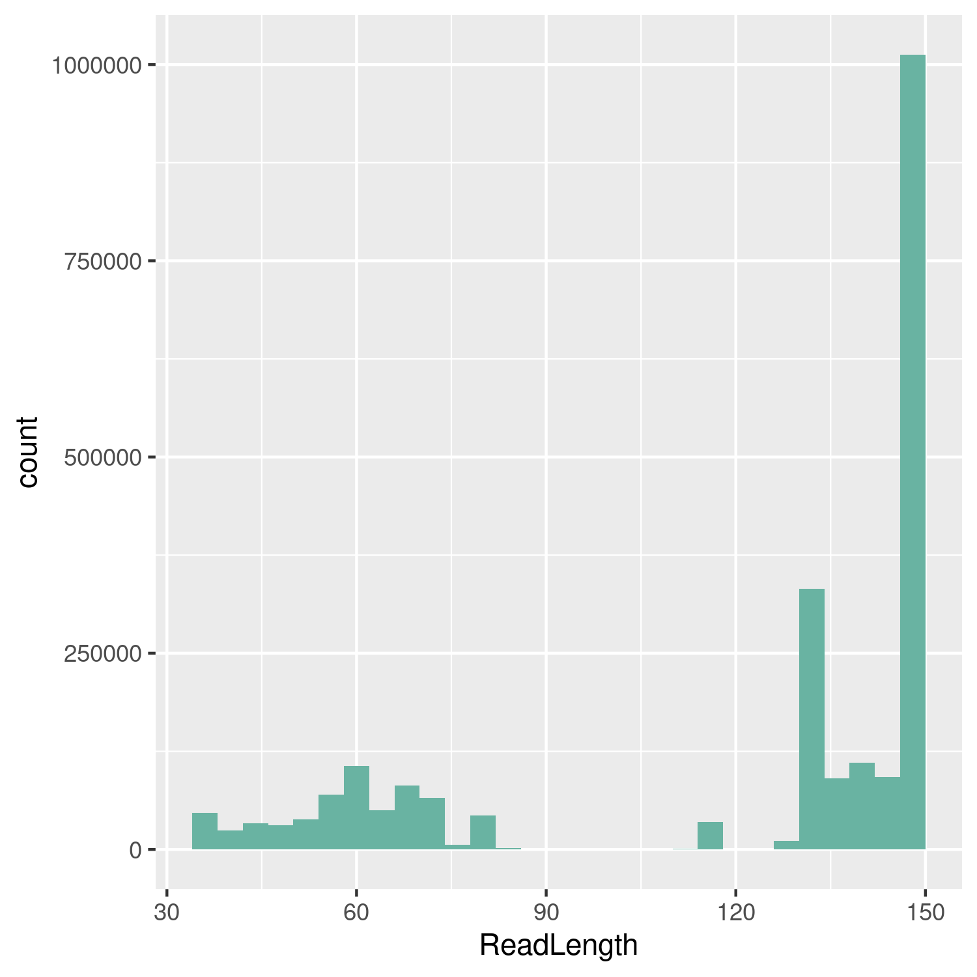
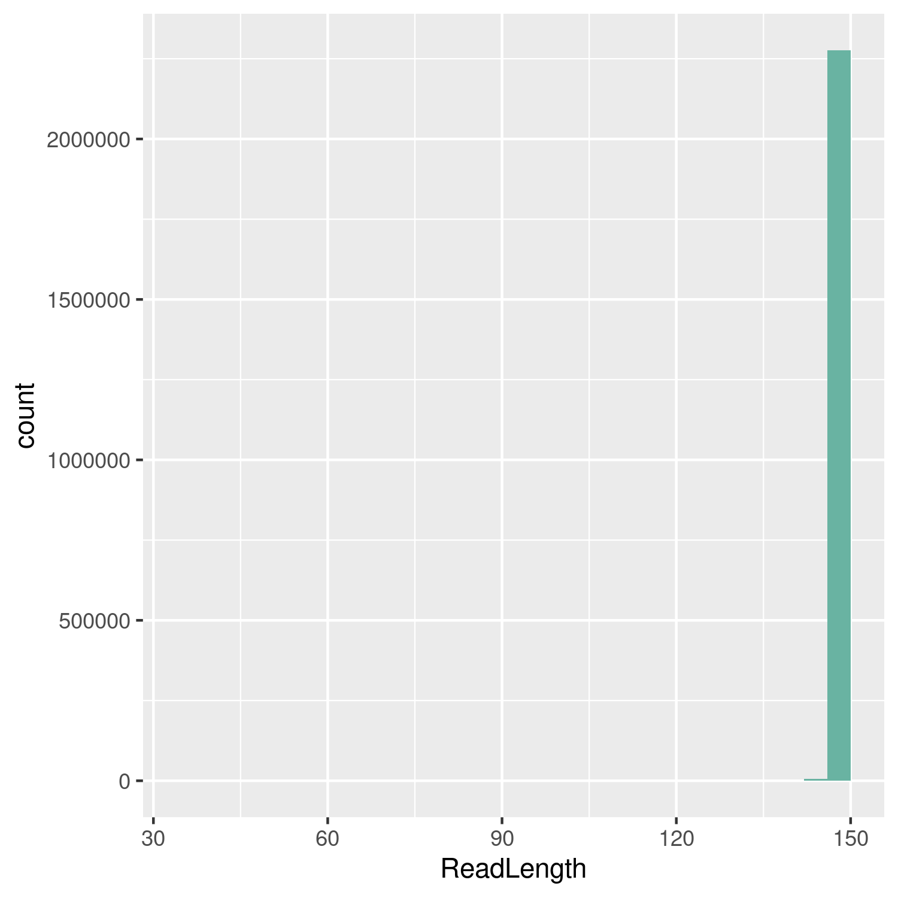
RAW DATA PROCESSING
Before trim
Contaminants?
Read 1 (>2.5 M reads)
Read 2 (>2.5 M reads)

Slide 38
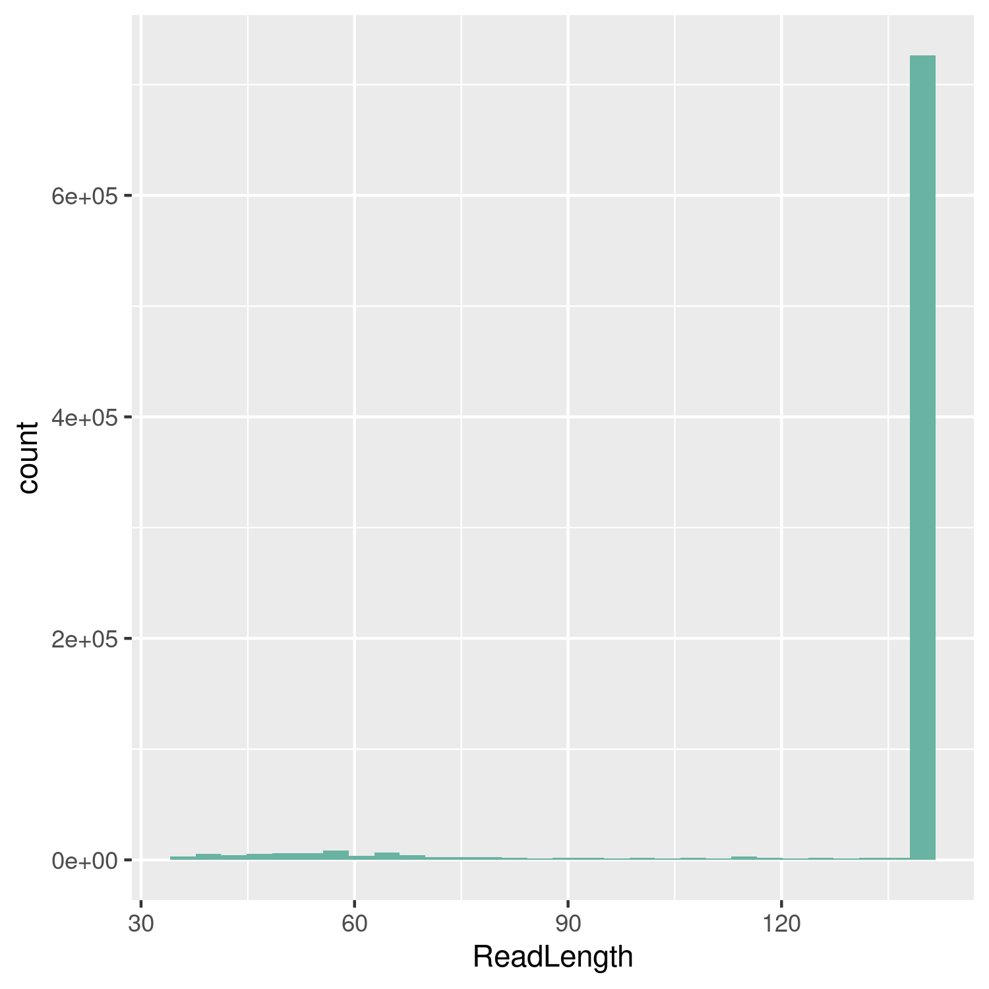
RAW DATA PROCESSING
After trim
Read 1 (~700K reads)
Read 2 (~700K reads)
Trade-off

Slide 39
RAW DATA PROCESSING
UPSTREAM ANALYSIS WORKFLOW
Yes
Mapped post-proccessing
Mapping
bwa
GATK
Quality looks good?
raw data
QC
Aligment QC
FastQC
No
Trimming
GATK
Trimmomatic
FastQC
Downstream Analysis

Slide 40
ALIGNMENT

Slide 41
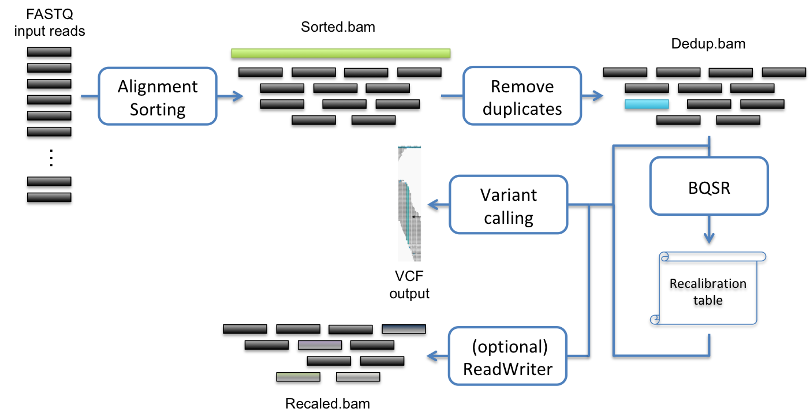
ALIGNMENT & MAPPED POST-PROCESSING
ALIGNMENT & POST-PROCESSING WORKFLOW
QC checked

Slide 42
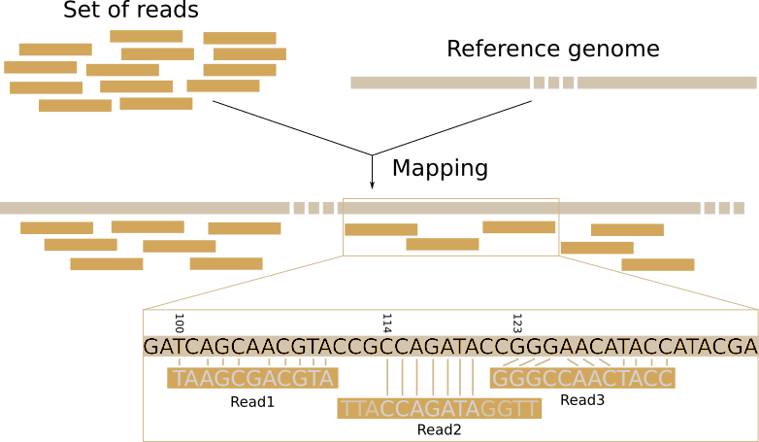
ALIGNMENT / MAPPING
ALIGNMENT

Slide 43
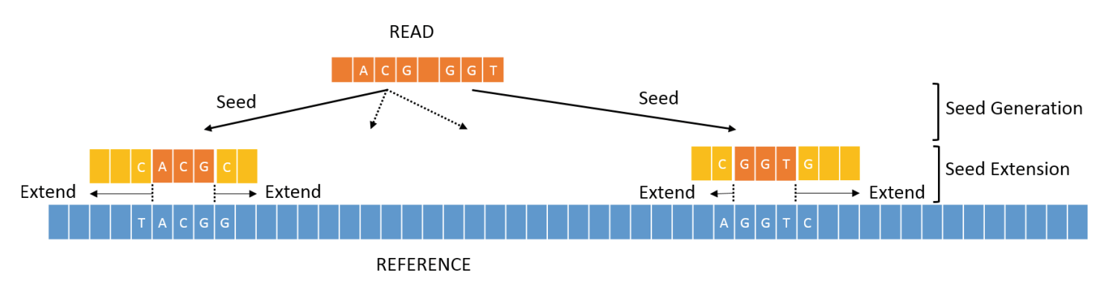
ALIGNMENT / MAPPING
ALIGNMENT
BWA: Burrows-Wheeler Alignment tool
The most widely used aligners for Illumina data
Based on BWT Algorithms
BWA-MEM was developed for reads of ≥70 bases, for shorter reads it is advisable to use the standard BWA algorithm. Both are provided by the same tool.
BWA mem algorithm

Slide 44
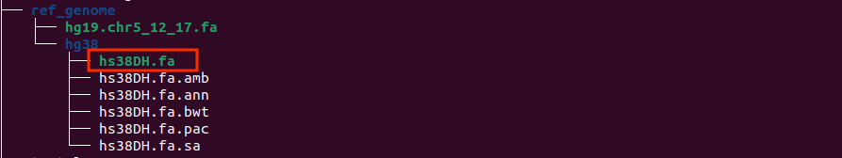

ALIGNMENT / MAPPING
ALIGNMENT
Hands-on: Using BWA as an aligner (This may take a while)
First: Index the reference genome.
Syntax:
bwa index -a bwtsw hg38.fa
When finished, we will have the following files like this:

Slide 45
ALIGNMENT / MAPPING
ALIGNMENT
Hands-on: Using BWA to align S11 data.
Syntax:
bwa mem -t 4 \
-R '@RG\tID:rg1\tSM:S11\tPL:illumina\tLB:lib1\tPU:M07220:1:TGCAGCTA+CCTAGAGT' \
$p_ref/hg38.fa \
$p_trim/S11_L001_R1_trimmed_paired.fastq.gz \
$p_trim/S11_L001_R2_trimmed_paired.fastq.gz > $p_align/S11_aln.sam
Input
Output
R1.fastq
R2.fastq
reference.fa
SAM/BAM

Slide 46
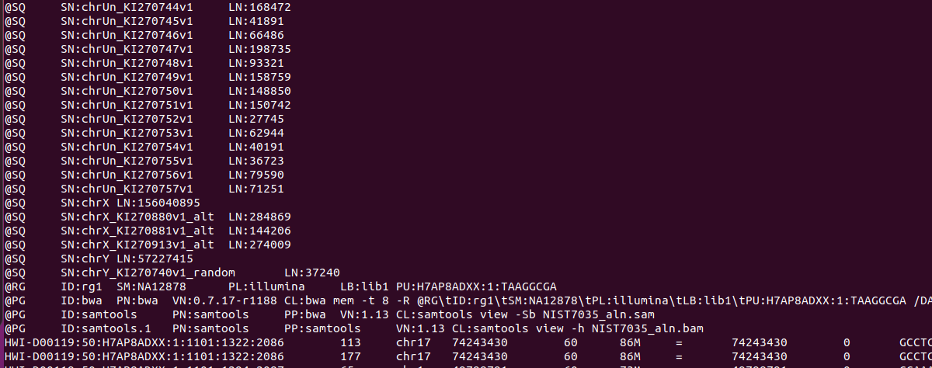

ALIGNMENT / MAPPING
ALIGNMENT
Introduce to SAM/BAM file > SAM format
Sequence Alignment/Map (SAM) format is a tab-delimited text format that aims to be a universal format for storing alignments of NGS reads to a reference genome.
Header (begin with ‘@’) + Alignment section.
Header of a SAM file
https://en.wikipedia.org/wiki/SAM_(file_format)

Slide 47
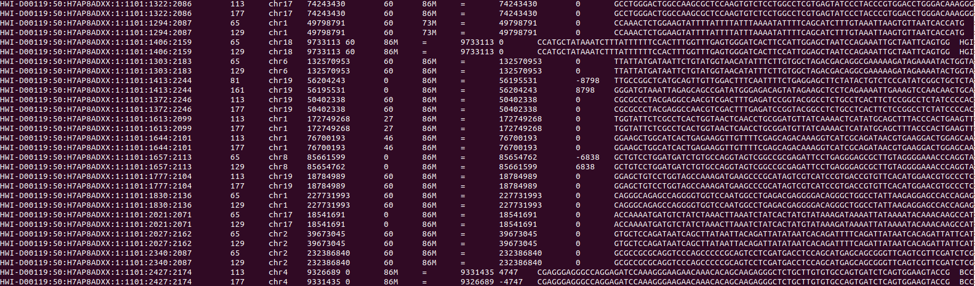
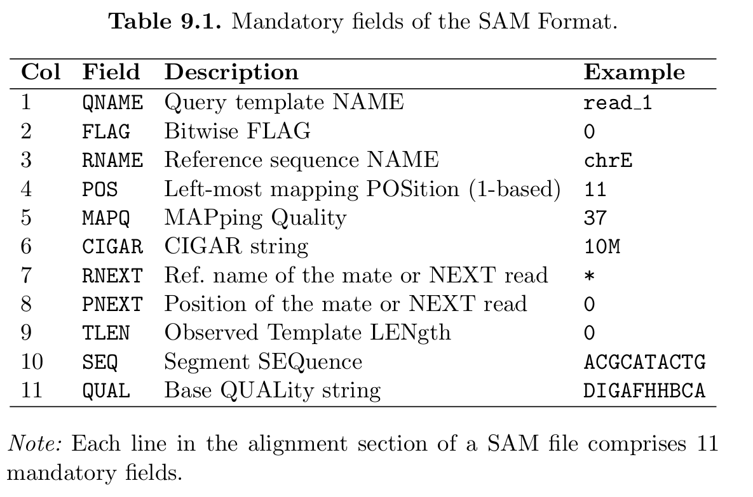
ALIGNMENT / MAPPING
ALIGNMENT
SAM/BAM file > SAM format
Alignment sections have 11 mandatory fields, as well as a variable number of optional fields.
QNAME
FLAG
RNAME
POS
MAPQ
CIGAR
RNEXT
PNEXT
TLEN
SEQ
Alignment section
SAM format: 11 mandatory fields

Slide 48
ALIGNMENT / MAPPING
ALIGNMENT
SAM/BAM file > Flagstats
Flagstats
1629692 + 0 in total (QC-passed reads + QC-failed reads)
1629194 + 0 primary
0 + 0 secondary
498 + 0 supplementary
0 + 0 duplicates
0 + 0 primary duplicates
1618417 + 0 mapped (99.31% : N/A)
1617919 + 0 primary mapped (99.31% : N/A)
1629194 + 0 paired in sequencing
814597 + 0 read1
814597 + 0 read2
1603792 + 0 properly paired (98.44% : N/A)
1617768 + 0 with itself and mate mapped
151 + 0 singletons (0.01% : N/A)
108 + 0 with mate mapped to a different chr
53 + 0 with mate mapped to a different chr (mapQ>=5)
The flagstat function of SAMtools provides a summary of the number of records corresponding to each of the bit flags.

Slide 49
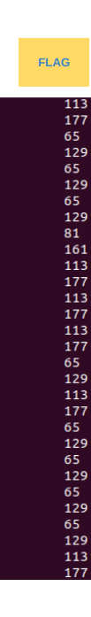


ALIGNMENT / MAPPING
ALIGNMENT
SAM/BAM file > Bit wise Flag
“The bitwise flag is a 16-bit integer that encodes various properties of the read and its alignment to the reference genome.”
Website interpret bitflag
https://broadinstitute.github.io/picard/explain-flags.html

Slide 50


ALIGNMENT / MAPPING
ALIGNMENT
SAM/BAM file > MAPQ
“Mapping Quality Scores (MAPQ) quantify the probability that a read is misplaced.”
MAPQ
In BWA-MEM, MAPQ score:
Based on Phred score
Range: 0 to 60
Higher scores indicating greater confidence in the mapping.
0: read could map multiple locations.
60: unique, highly confident mapping.
Different mapping tools may produce a different MAPQ.

Slide 51



ALIGNMENT / MAPPING
ALIGNMENT
SAM/BAM file > CIGAR
CIGAR string describes how each read aligns to the reference genome.
CIGAR
Syntax:
<length><operation>
CIGAR: 2M2D3M1I2M
2 matches
2 deletes
3 matches
1 insert
2 matches

Slide 52


ALIGNMENT / MAPPING
Insert size calculation
Insert size < 2x read length
→ Overlap & Partial overlap
→ Miss information
https://www.sciencedirect.com/science/article/pii/S0888754321003815

Slide 53


ALIGNMENT / MAPPING
Chromosome mapped
Most reads mapped to chr13 & chr17

Slide 54

ALIGNMENT / MAPPING
Integrative Genomics Viewer (IGV)
https://igv.org/app/
Notes:
chr13:32,328,039-32,350,355
chr17:43,093,015-43,093,522

Slide 55
ALIGNMENT / MAPPING
UPSTREAM ANALYSIS WORKFLOW
Yes
Mapped post-proccessing
Mapping
bwa
GATK
Quality looks good?
raw data
QC
Aligment QC
FastQC
No
Trimming
GATK
Trimmomatic
FastQC
Downstream Analysis

Slide 56
MAPPED READ POST-PROCESSING

Slide 57
MAPPED READS POST-PROCESSING
Post-processing:
Sorting, Indexing BAM file and Mark Duplicates

Slide 58

4. Mapped reads post-processing
MAPPED READS POST-PROCESSING
Marking & removing duplicates
Duplicates read:
PCR duplicates
Optical duplicates
→ Duplicate reads can be problematic in downstream analyses, particularly in variant calling

Slide 59

MAPPED READS POST-PROCESSING

Slide 60



MAPPED READS POST-PROCESSING
Marking & removing duplicates
Sort the BAM file by coordinate
gatk SortSam \
--INPUT S11_aln.bam \
--OUTPUT S11_aln_sorted.bam \
--SORT_ORDER coordinate
Mark Duplicates
gatk MarkDuplicates \
--INPUT S11_aln_sorted.bam \
--OUTPUT S11_aln_dedup.bam \
--METRICS_FILE S11_MarkDup.metrics

Slide 61



MAPPED READS POST-PROCESSING
View the marked duplicate reads with flag
samtools view S11_aln_dedup.bam
samtools view -f 0x400 S11_aln_dedup.bam
Discriminate Optical and PCR duplication
Marked the read as an optical duplicated (DT:Z:SQ) & PCR duplicated (DT:Z:LB)
gatk MarkDuplicates \
--INPUT S11_aln_sorted.bam \
--OUTPUT S11_aln_dedup.bam \
--METRICS_FILE S11_MarkDup_PCR_OPT.metrics \
--TAGGING_POLICY All
samtools view -f 0x400 NIST7035_dedup.bam | grep DT:Z:SQ | less -S

Slide 62

MAPPED READS POST-PROCESSING
S11_aln_sorted.bam
Most are PCR duplicates

Slide 63

MAPPED READS POST-PROCESSING
Remove Duplicate
gatk MarkDuplicates \
--INPUT $p_align/sample2/NIST7035_sorted.bam \
--OUTPUT $p_align/sample2/NIST7035_remove_dup.bam \
--METRICS_FILE $p_align/sample2/NIST7035_remove_dup.metrics2 \
--REMOVE_DUPLICATES true
But should we remove duplicates?

Slide 64
ALIGNMENT DATA: QUALITY CONTROL
2 key parameters for Alignment Quality Control:
Read Depth
Coverage

Slide 65

ALIGNMENT DATA: QUALITY CONTROL
The more reads there are, the more certain we can be about the genotype at any given position.

Slide 66



ALIGNMENT DATA: QUALITY CONTROL
WES & Target Sequencing

Slide 67
ALIGNMENT DATA: QUALITY CONTROL
Calculate coverage
bedtools coverage \
-hist \
-a $p_ref/hg38_exome.bed \
-b $p_align/sample2/NIST7035_remove_dup.bam > NIST.bed.cov
#
grep ^all NIST.bed.cov > NIST.all.cov

Slide 68


ALIGNMENT DATA: QUALITY CONTROL
90% bases < 20X
Keep duplicates
Remove duplicates
A depth of coverage of 300X or more is considered to be sufficient for most applications.

Slide 69
SUMMARY
UPSTREAM ANALYSIS WORKFLOW
Yes
Mapped post-proccessing
Mapping
bwa
GATK
Quality looks good?
raw data
QC
Aligment QC
FastQC
No
Trimming
GATK
Trimmomatic
FastQC
Downstream Analysis

Slide 70
SUMMARY
Low quality reads filtered
Contaminants eliminated
Alignment rate and quality is good
Almost duplicated reads come from PCR
Keep duplicates
→ Quality reads are ready for downstream analysis

Slide 71

REFERENCES
Robinson, P.N., Piro, R.M., & Jager, M. (2017). Computational Exome and Genome Analysis (1st ed.). Chapman and Hall/CRC. https://doi.org/10.1201/9781315154770

Slide 72
THANK YOU

